Slide 1
EE 595 Lab9

Slide 2
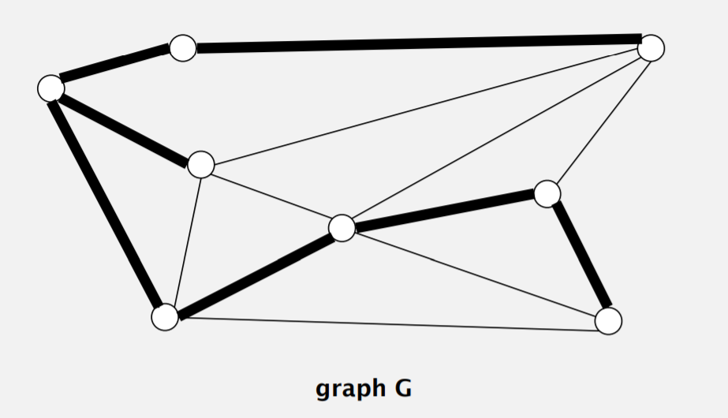
Spanning Tree
Def. A spanning tree of G is a subgraph T that is:
1). Connected;
2). Acyclic;
3). Includes all of the vertices

Slide 3
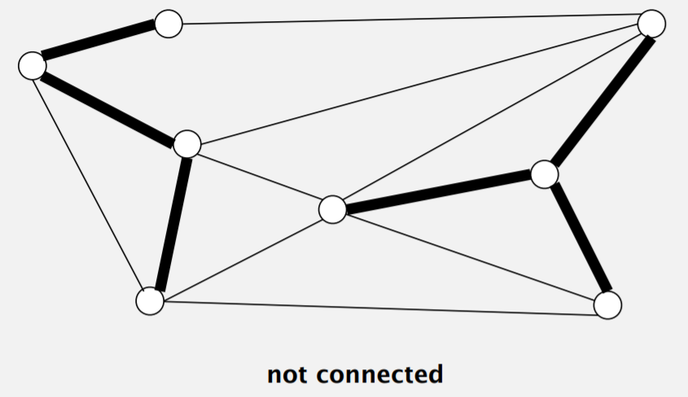
Spanning Tree

Slide 4
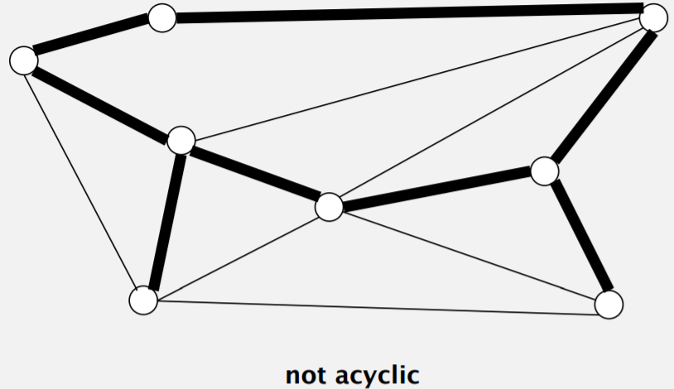
Spanning Tree

Slide 5
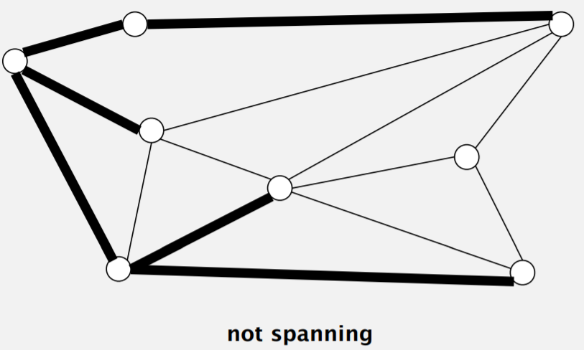
Spanning Tree

Slide 6
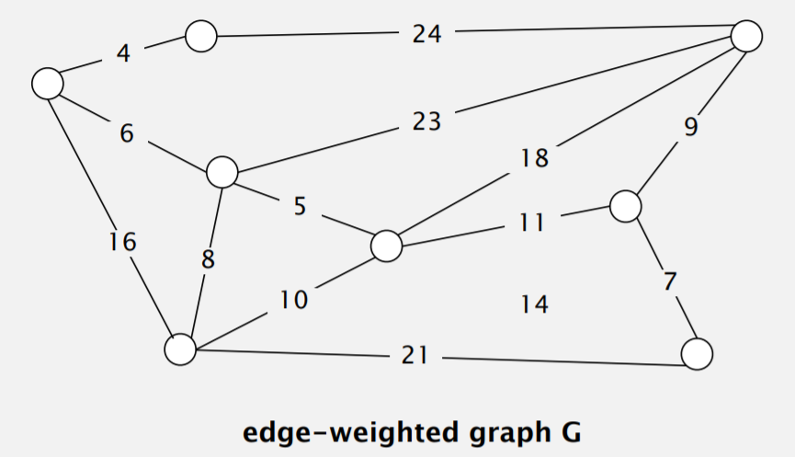
Minimum Spanning Tree
Given. Undirected graph G with positive edge weights (connected).
Goal. Find a min weight spanning tree.

Slide 7
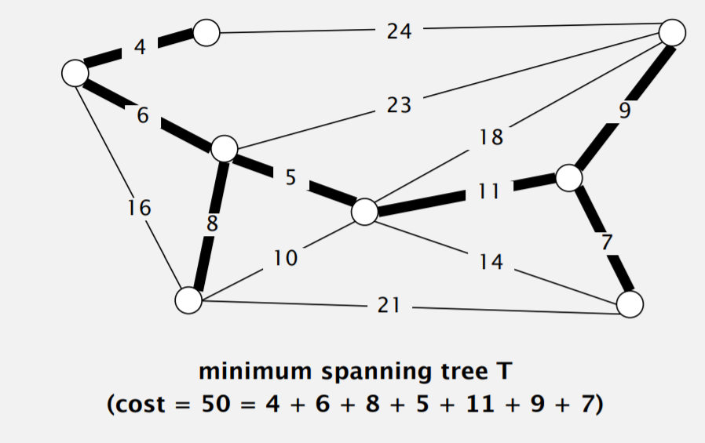
Minimum Spanning Tree
Given. Undirected graph G with positive edge weights (connected).
Goal. Find a min weight spanning tree.

Slide 8
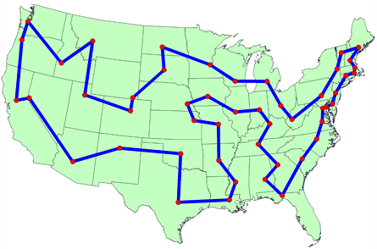
Travelling salesman problem
Given a list of cities and the distances between each pair of cities, what is the shortest possible route that visits each city and returns to the origin city?

Slide 9
Simulated Annealing
probabilistic search
http://www.biostat.jhsph.edu/~iruczins/teaching/misc/annealing/slides.sim.anneal.pdf

Slide 10
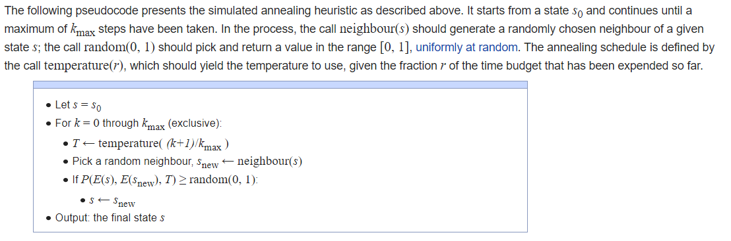
Simulated Annealing

Slide 11
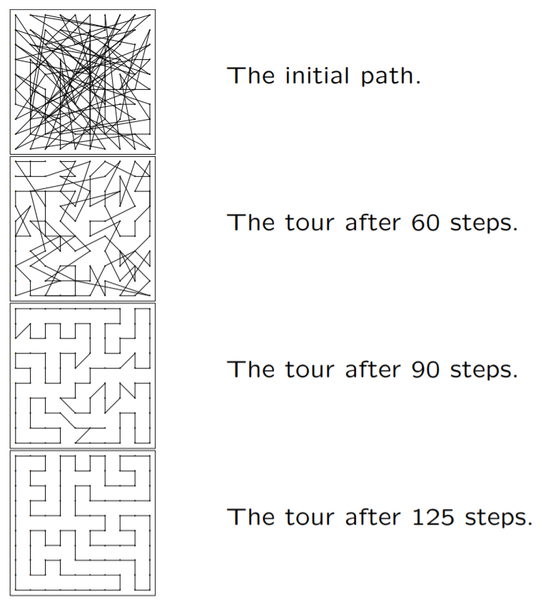
Simulated Annealing

